Slide 1
My Capstone Project Benchmark Video

Slide 2
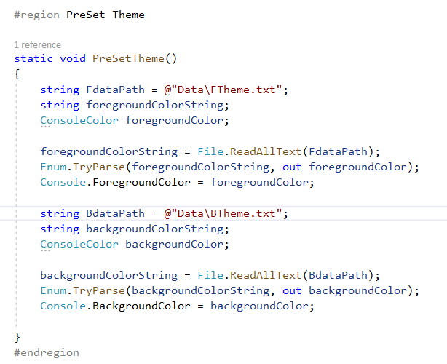
Talk about: Preset Theme and what its about

Slide 3
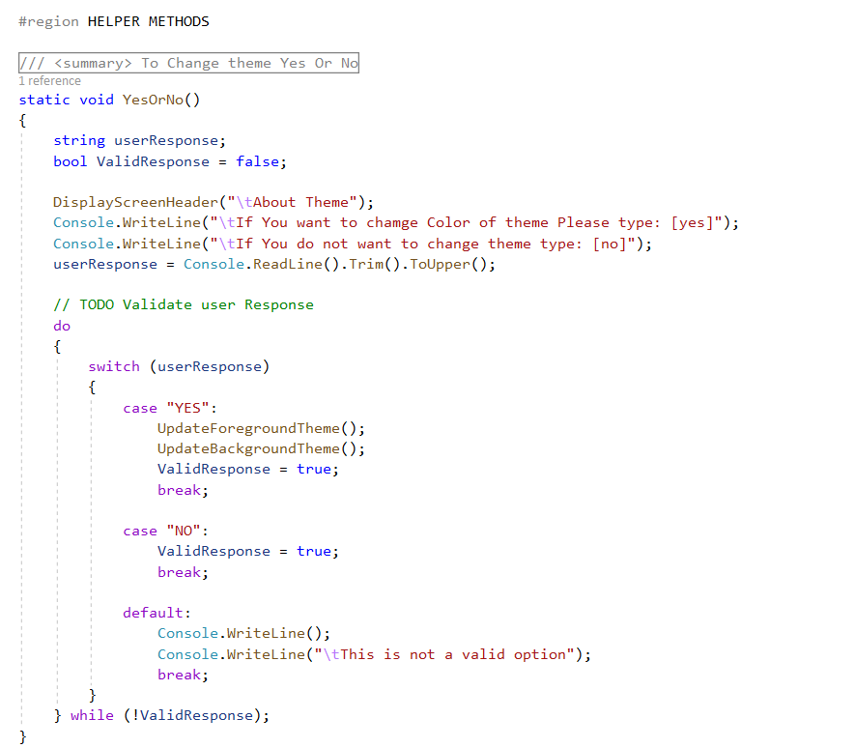
Talk About Yes or No: What this is and what it does

Slide 4
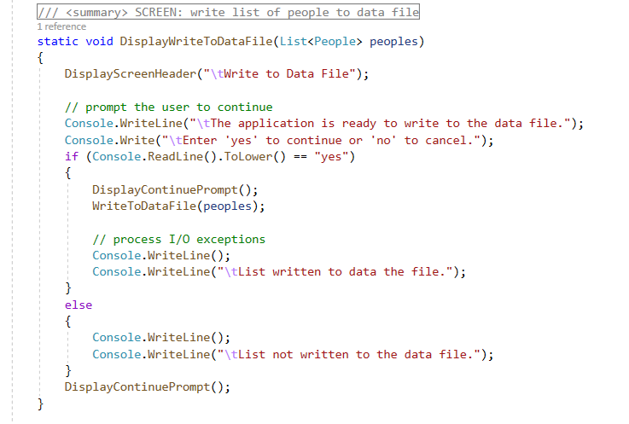
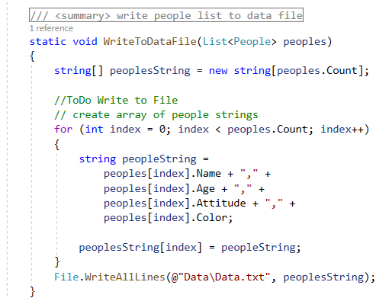
Writing to the Data File

Slide 5
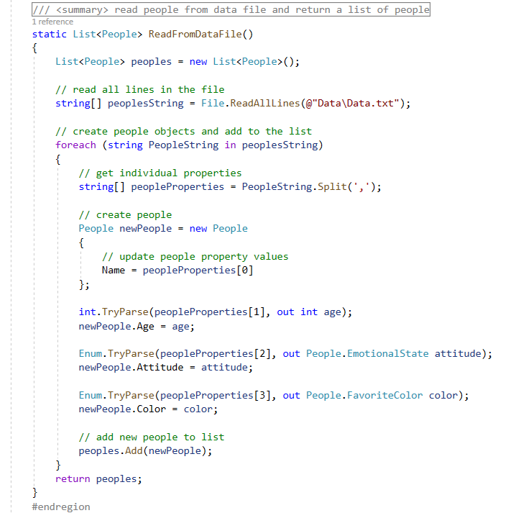
Displaying what is in the Data File

Slide 6
The End
Thanks for Listening

